Slide 1
Cell Based Assays using a Multi Mode Microplate Imaging System
Dominic Herring
BioTek Instruments

Slide 2
What does a conventional multi-mode reader give you?

Slide 3
Microplate Based Assays
Multimode Detection Applications
Apoptosis
Bacterial adhesion
Biofuel research
Calcium mobilization
Cell adhesion
Cell expression
Cell proliferation
Cell viability & cytotoxcity
Chemotaxis
Colorimeric assays
Cytochrome P450 induction/inhibition
Cytokine analysis
DNA quantification
eGFP quantification
ELISA
Enzyme activity
Enzyme kinetics
Epigenetics
Immunoassays
Kinase assays
Kinetic yeast growth profiles
Live cell analysis
Metabolic activity
Mitochondrial membrane potential
NADH/NADPH
Na⁺/H⁺ exchange
Nucleic acid quantification
Oxidative burst
Oxidation reactions
PAMPA
PCR product quantification & quality
Protease activity
Protein aggregation
Protein quantification
Receptor binding studies
Reporter gene
Signal transduction
Single Nucleotide Polymorphisms
Spectral Scanning
Toxicology

Slide 4
Assay types commonly measured in a microplate
Biochemical assays
  Allow important information about the concentration of a given bio-molecule, or its activity to be obtained, but are not directly related to full cellular activity, e.g. nucleic acid quantitation
  Very common, both from a historical perspective and the simplicity to perform these assays
Cell-based assays
  Increasing in popularity
  Generates more accurate information about the behavior of a bio-molecule within its natural environment
  Microplates satisfy the desire for increased throughput, with different detection technologies measurement, such as microplate readers, imaging systems, etc

Slide 5

Cell-based assays
GPCR
Reporter Gene
Ion Channels
ROS
Nuclear Receptor
Protein / enzyme (e.g. kinase)
Cytotoxicity, Cell proliferation
Cell Migration

Slide 6
Cell-based assays
Conventional approach to cell based microplate assays has been the microplate reader
Multi-mode readers have evolved to be capable of measuring multiple assay types to cope with the needs of researchers:
  Absorbance
  Fluorescence including TRF, FRET, FP
  Luminescence
  Dispensers
  Gas controlling mechanisms
As well as advances in different optics designs
  Optical filter based for best sensitivity
  Monochromator based for increased flexibility

Slide 7
Cell-based assays
GPCR
Reporter Gene
Ion Channels
ROS
Nuclear Receptor
Protein / enzyme (e.g. kinase)
Cytotoxicity, Cell proliferation
Cell Migration

Slide 8
Cell-based assays
GPCR
TRF / TR-FRET
Reporter Gene
Polarization
Luminescence
Ion Channels
Absorbance
Fluorescence
Fluorescence / FRET
ROS
Nuclear Receptor
Polarization
Luminescence
Luminescence
Protein / enzyme (e.g. kinase)
TRF / TR-FRET
Polarization
Cytotoxicity, Cell proliferation
Cell Migration
Luminescence
Fluorescence
Absorbance
Fluorescence

Slide 9
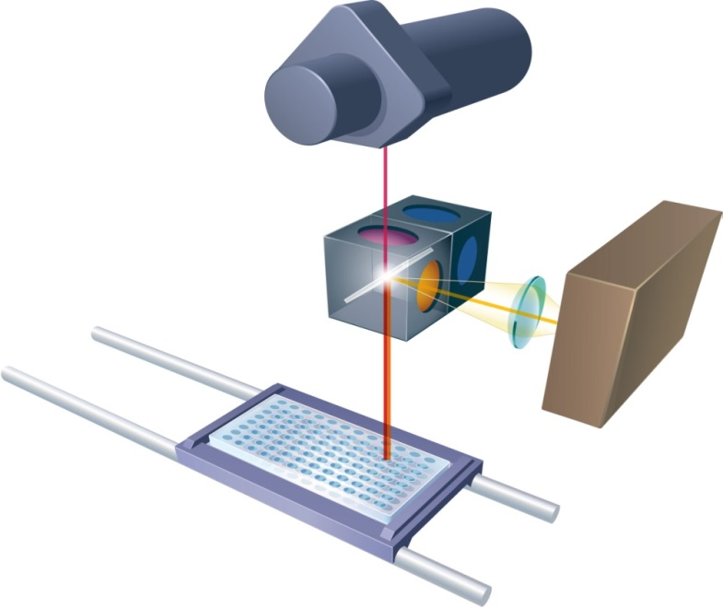
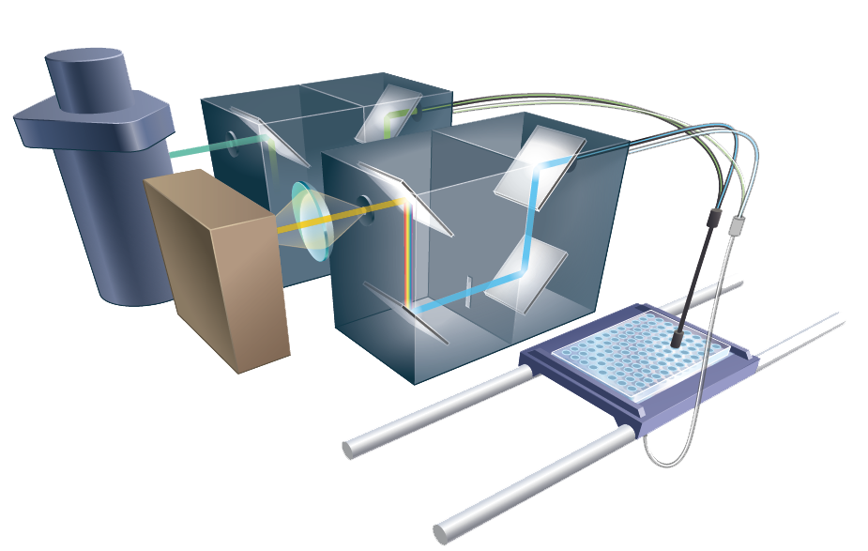
Cell-based assays
Multi-mode readers have evolved with different optics designs, each more suited to different applications
Optical filters for best sensitivity
Typical for TRF and FP assays
Monochromators for flexibility
Better for multiplexing & spectral shifts

Slide 10
High Level Hybrid Multi Mode Microplate Reader
P
D
EM
Dual
Mono
EX
Dual
Mono
M
PMT 2
L
F
T
Excitation
Emission
PMT 1
A
Xenon Flash
T = TRF light source
L = Luminescence
A = Absorbance
P = Fluorescence Polarization
D = Dispenser
F = Filter Fluorescence
M = Monochromator Fluorescence

Slide 11
Cell-based assays
GPCR
TRF / TR-FRET
Reporter Gene
Polarization
Luminescence
Ion Channels
Absorbance
Fluorescence
Fluorescence / FRET
ROS
Nuclear Receptor
Polarization
Luminescence
Luminescence
Protein / enzyme (e.g. kinase)
TRF / TR-FRET
Polarization
Cytotoxicity, Cell proliferation
Cell Migration
Luminescence
Fluorescence
Absorbance
Fluorescence
What data do you get from a microplate reader?

Slide 12
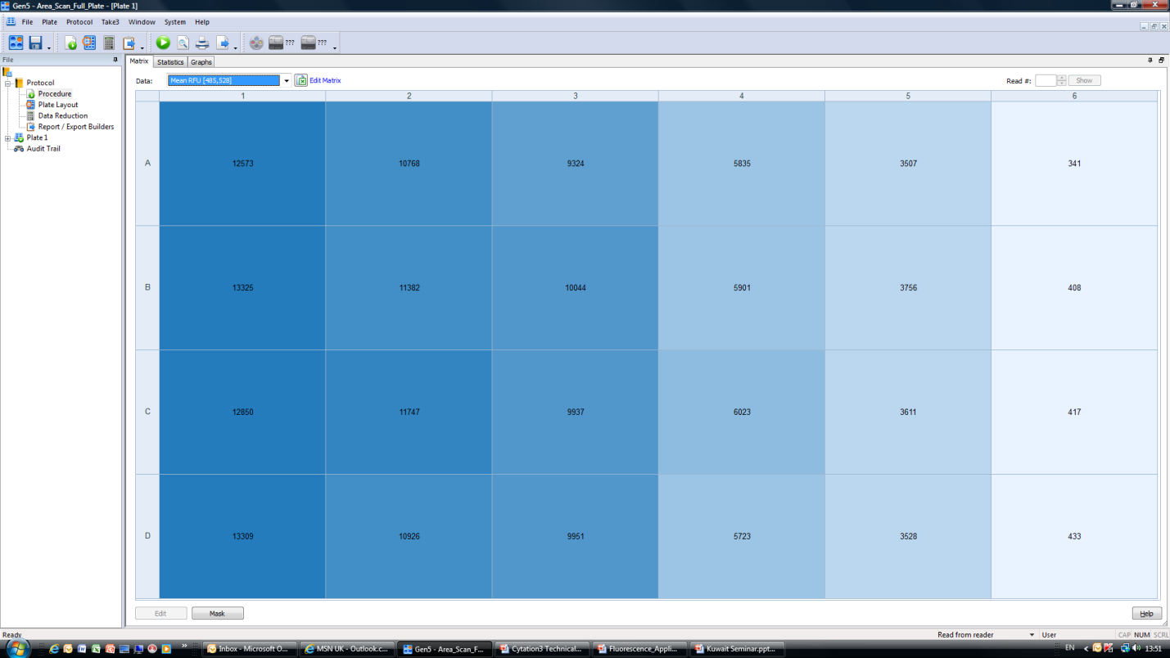
What do you get from a microplate reader?

Slide 13
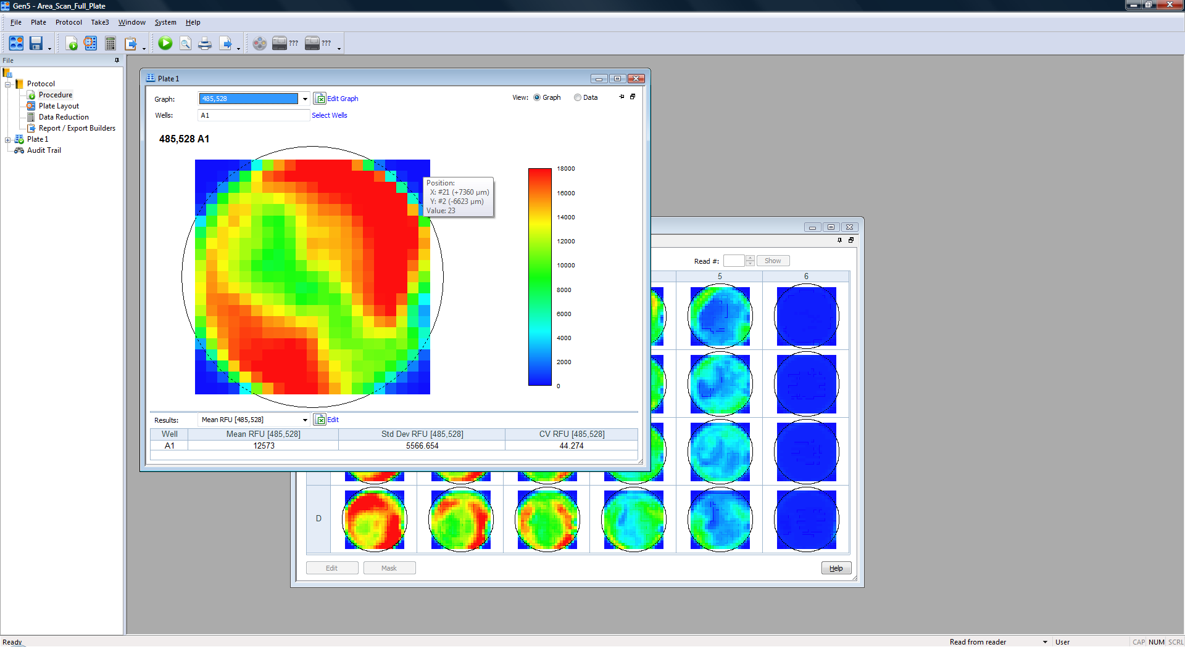
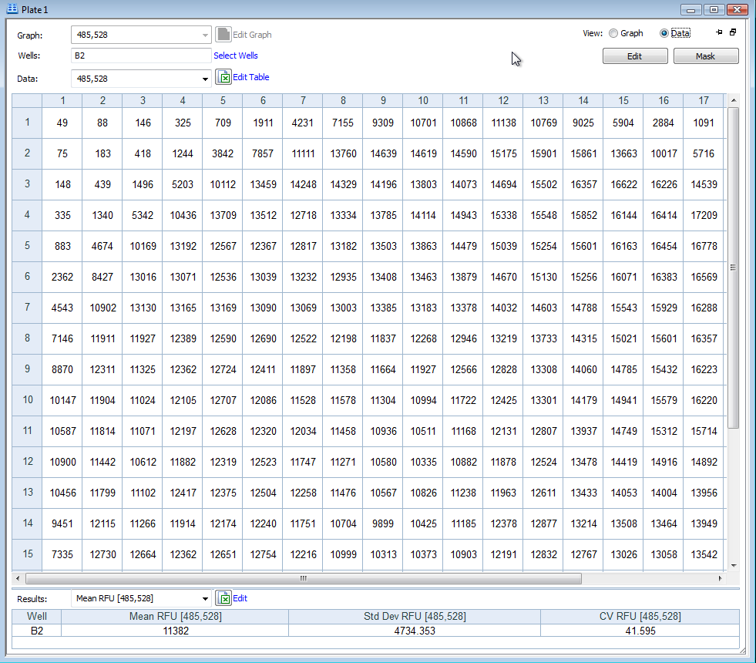
What do you get from a microplate reader?
Area scanning for more data

Slide 14
Limitations of a Microplate Reader in Cellular Assays
Large cell number (5000+) required for any sort of differential analysis
It is difficult to have the same number of cells in each well so ‘normalization’ math needs to be used by comparison to controls
There is no discrimination between signal and background
Changes in signal does not necessarily equate to changes in biological activity
Area scanning maps are indirect images of cell location and activity, and are of a low resolution due to optical design

Slide 15
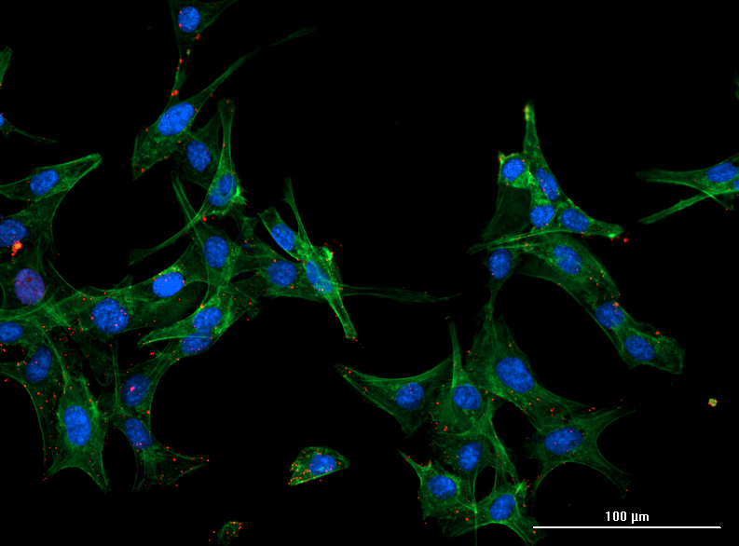
We can over come these issues through imaging
SKOV-3 Cells 20x
Application Note: Multiplexed Assay for IL-6 Secretion and Cell Viability Using an Epithelial Ovarian Cancer Cell Line

Slide 16
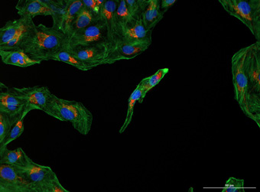
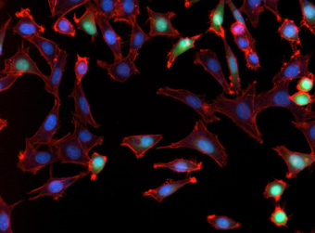
What do you get from an image?
SKOV-3 Cells
Cetuximab binding to EGFR
Rich phenotypic data by seeing whats really happening within your cells…
U2-OS Cells
Mitochondrial Staining
NIH 3T3 Cells
Expressing GFP

Slide 17
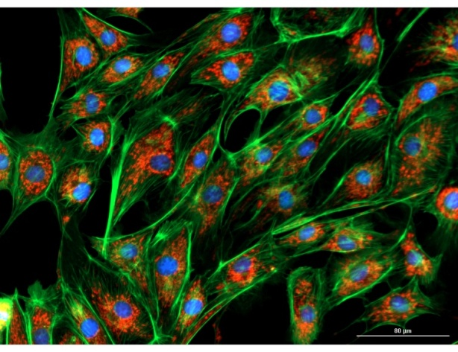
Evolution of Cell based Assays In Microplate format
Microplate Reader
Scanning Reader
Imaging Microplate System

Slide 18
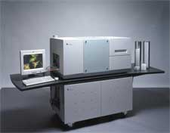
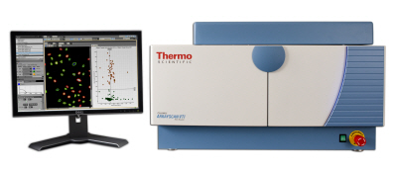
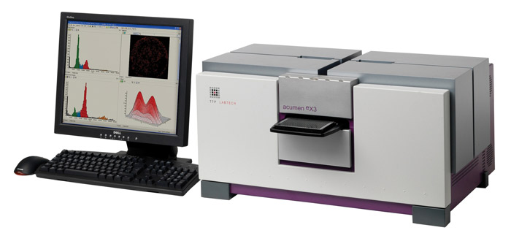
High Content Screening (HCS) imaging systems
High quality images delivering rich phenotypic data through advanced algorithms
Range of different magnifications to suit assay requirements
Environmental control options
But very expensive
Complex software
Extensive data management (single image 384 well plate ~ 1GB+)

Slide 19
Microplate Based Assays
Multimode Detection Applications
Apoptosis
Bacterial adhesion
Biofuel research
Calcium mobilization
Cell adhesion
Cell expression
Cell proliferation
Cell viability & cytotoxcity
Chemotaxis
Colorimeric assays
Cytochrome P450 induction/inhibition
Cytokine analysis
DNA quantification
eGFP quantification
ELISA
Enzyme activity
Enzyme kinetics
Epigenetics
Immunoassays
Kinase assays
Kinetic yeast growth profiles
Live cell analysis
Metabolic activity
Mitochondrial membrane potential
NADH/NADPH
Na⁺/H⁺ exchange
Nucleic acid quantification
Imaging Applications
Cell Migration
  Scratch Assay
  Wound Healing (Oris Assay)
Colocalization
Counting
  Cell Proliferation
  Cell Toxicity
  Cell Viability
  Nuclear Count
  Whole Organism Counting (C. Elegans)
Hypertrophy
Hit Picking
Montage
Neurite Outgrowth
Nuclear Translocation
  Caspase-3 translocation during apoptosis
Protein Expression
  P53, P21, c-Jun
Subpopulation Analysis
  Apoptosis/Necrosis
  Cell Cycle
  Cell Infection by virus/parasite
  Hypoxia& Oxidative Stress
  Mitotic Index
  Protein Expression
  Transfection Efficiency
Time Lapse/Kinetics
  Caspase-3 translocation
Oxidative burst
Oxidation reactions
PAMPA
PCR product quantification & quality
Protease activity
Protein aggregation
Protein quantification
Receptor binding studies
Reporter gene
Signal transduction
Single Nucleotide Polymorphisms
Spectral Scanning
Toxicology

Slide 20
Problems Associated with Standard Microplate Cell Based Assays
Why an Image gives you more data options

Slide 21
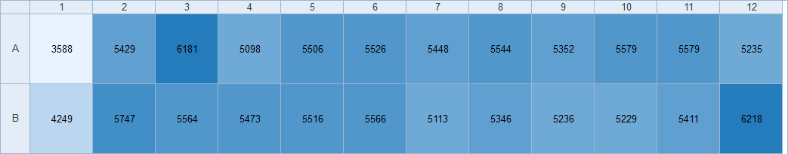
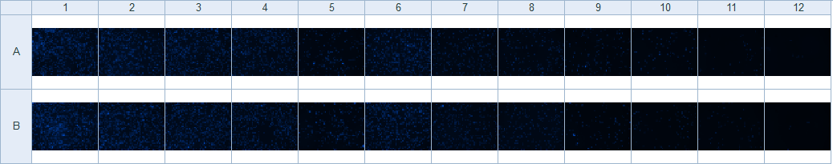
Lots of cells are required for any sort of differential analysis
Serial dilution

Slide 22
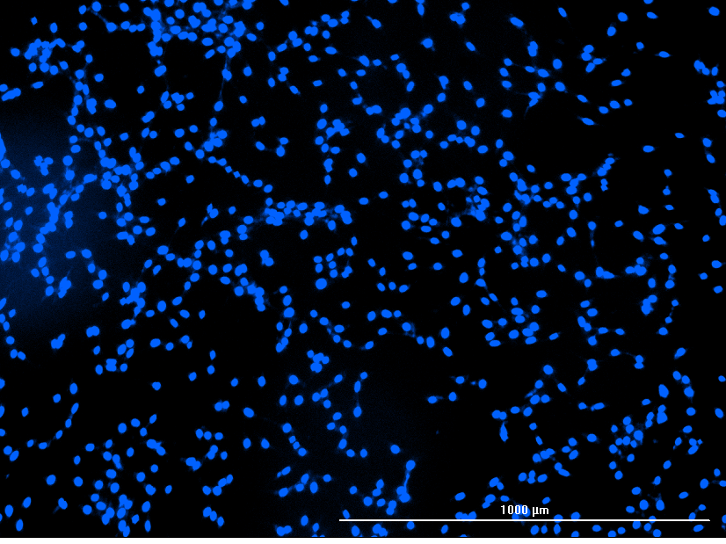
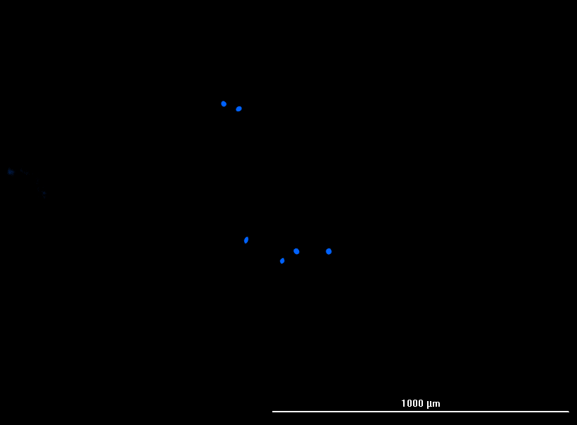
Lots of cells are required for any sort of differential analysis
Well A1
Well A12
Read Data 5429
Read Data 5235

Slide 23
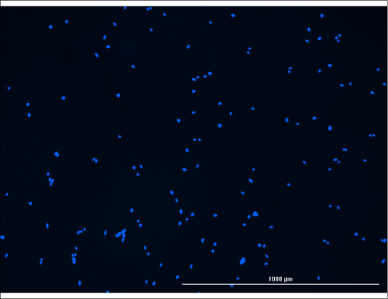
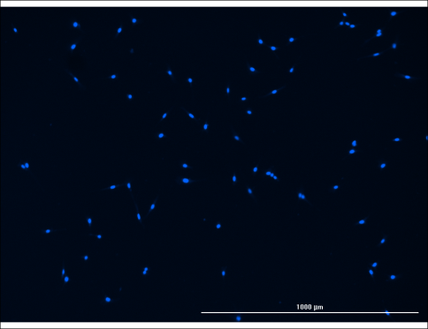
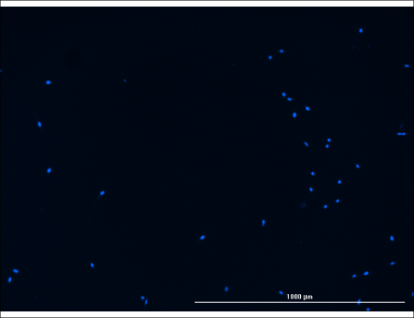
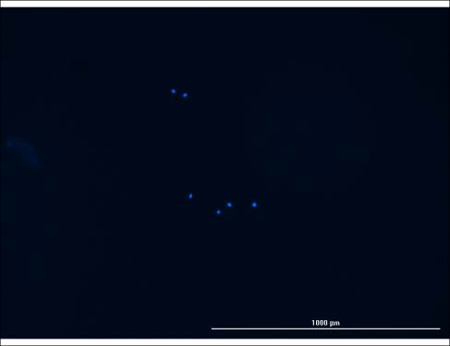
Lots of cells are required for any sort of differential analysis
A09
A10
A11
A12
137 Cells
73 Cells
37 Cells
6 Cells
5352 RFU
5579 RFU
5579 RFU
5235 RFU

Slide 24
Reader v’s Imager for cell based analysis
Instrument
Count or Read
Reader
Imager
True cell count

Slide 25
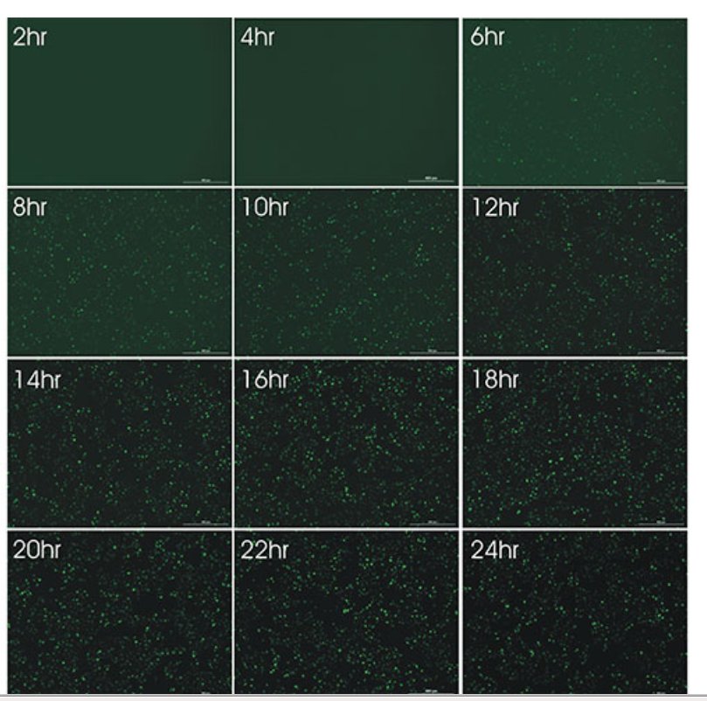
No Discrimination between Signal and Back Ground
GFP Expression in U-2 OS Cell infected with BacMam Virus.
Histone H3-GFP fusion protein is expressed in the nucleus.
Images were taken every 2 hours over a 24-hour time period after viral exposure to the cells

Slide 26
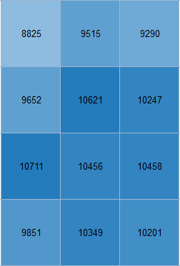
No Discrimination between Signal and Back Ground
GFP Expression in U-2 OS Cell infected with BacMam Virus.
Histone H3-GFP fusion protein is expressed in the nucleus.
Images were taken every 2 hours over a 24-hour time period after viral exposure to the cells

Slide 27
No Discrimination between Signal and Back Ground
GFP Expression in U-2 OS Cell infected with BacMam Virus.
Histone H3-GFP fusion protein is expressed in the nucleus.
Images were taken every 2 hours over a 24-hour time period after viral exposure to the cells

Slide 28
Data Changes = Expected Biological Activity Changes ???
Read Values from Inhibition Experiment
Value
Cell Count
Cell Count
Concentration

Slide 29
Many cell based assays require Microplate Readers and Imaging Instrumentation for effective interpretation of data.

Slide 30

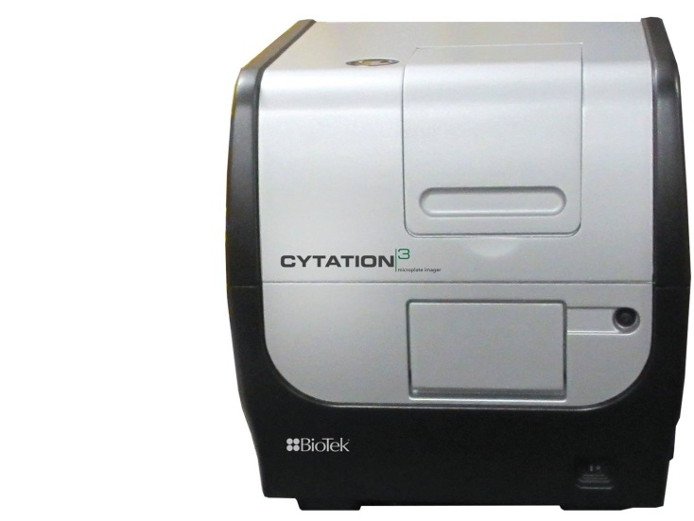
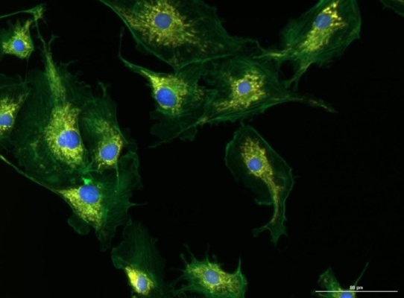

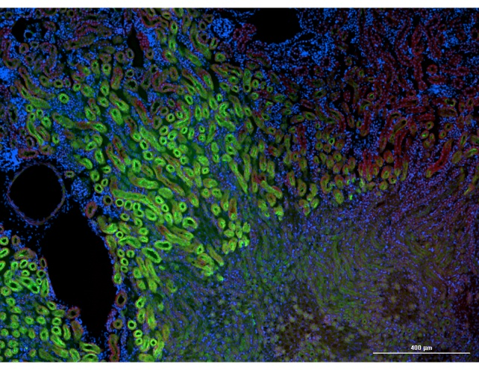
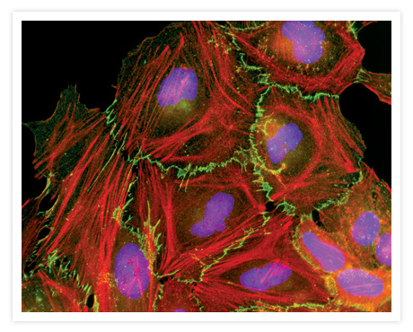
Introducing the Cytation3 from BioTek

Slide 31
What is Cytation3?
An affordable microplate imager to support increased cell biology research
A combined microplate reader / imager that provides new benefits such as a unique hit-picking feature
Easy-to-use software interface, familiar to microplate instrument users, to reduce learning curve for non-imaging experts

Slide 32
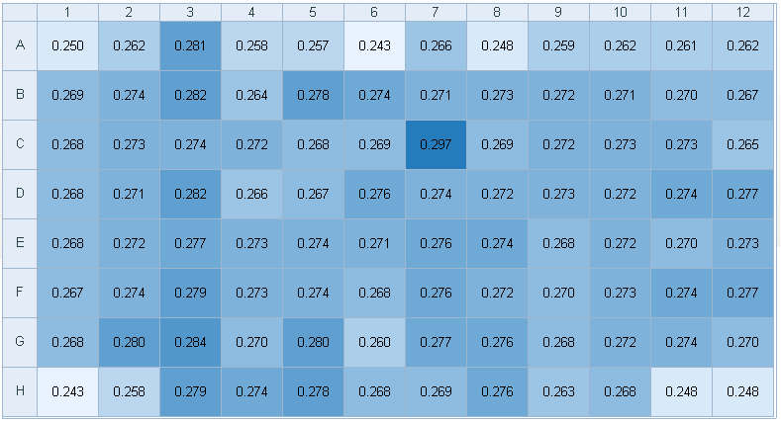
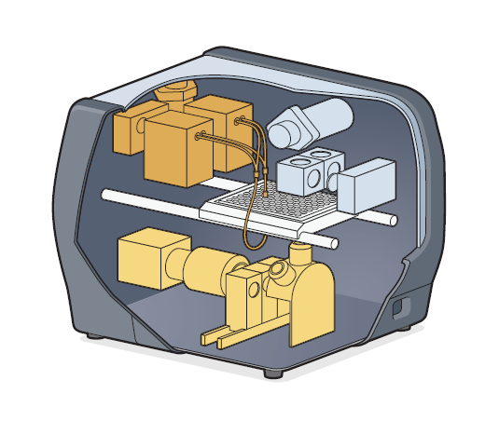

Cytation3 – Microplate Reader with Imaging
Quantitative numerical data
Fuller picture for cell biology research
Qualitative phenotypic data

Slide 33

Traditional Plate Reader - Filters
Quantitative data and sensitivity
Precisely measure cellular activity

Slide 34
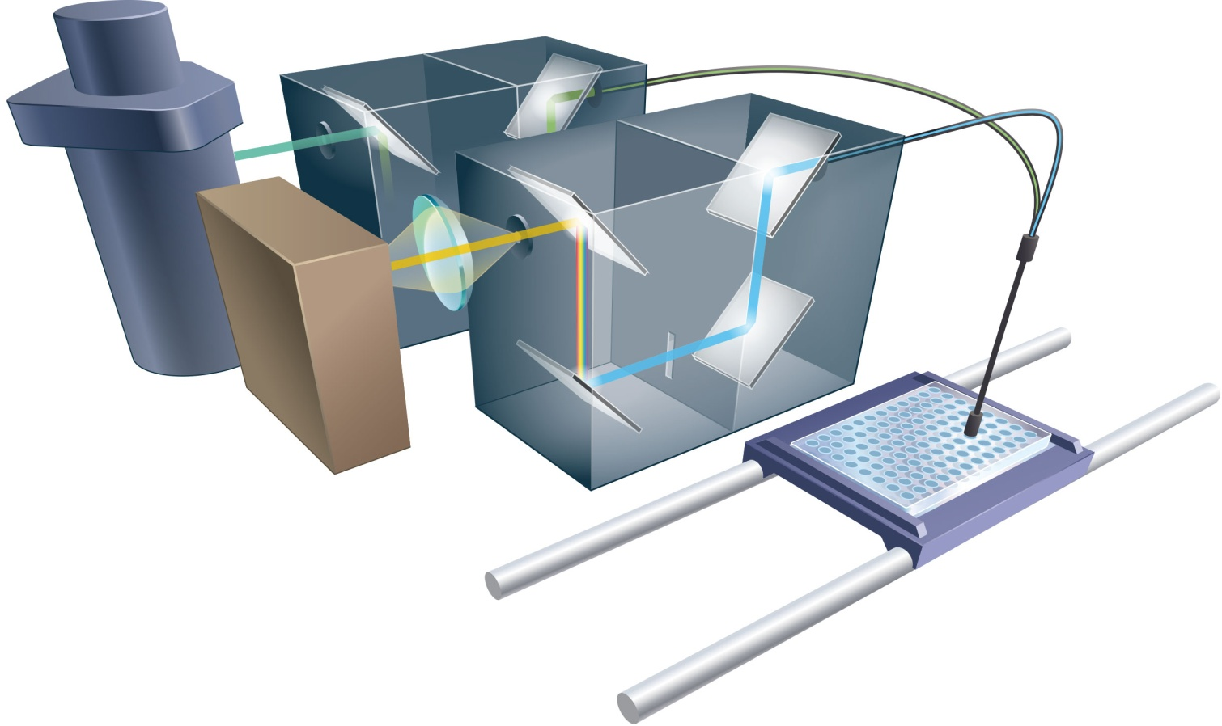
Traditional Plate Reader - Monochromators
Quantitative data and flexibility
Precisely measure cellular activity

Slide 35
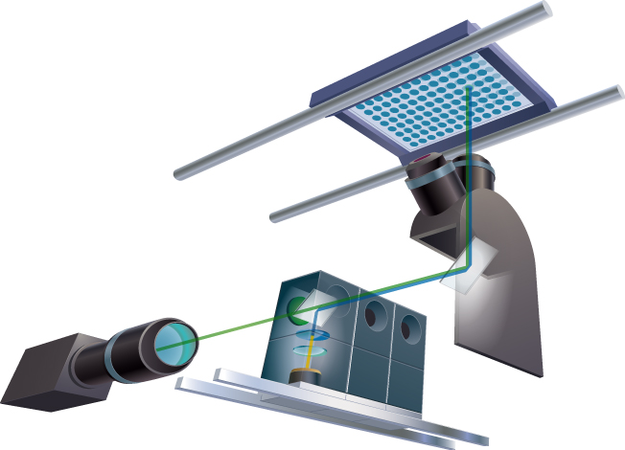

Imaging Optical Path
Qualitative and semi-quantitative data
Visualize change in phenotype

Slide 36
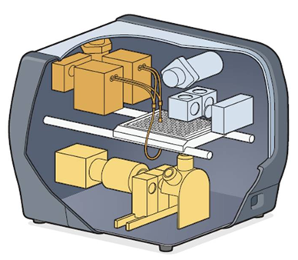
Modular and Upgradeable Design
1 (monochromator optics), 2 (filter optics) and 3 (imaging) are independent of each other
Any combination can be ordered
Any of these 3 systems can be added to the instrument at a later date
Cost-effective solution: purchase what you need now, upgrade later.
1
2
3

Slide 37
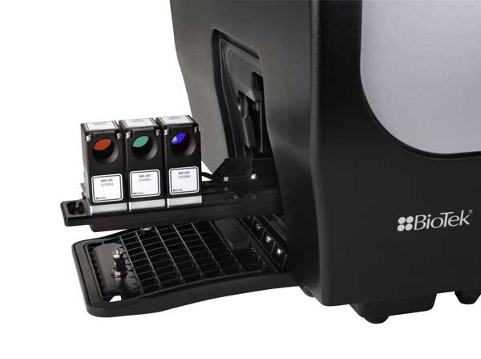
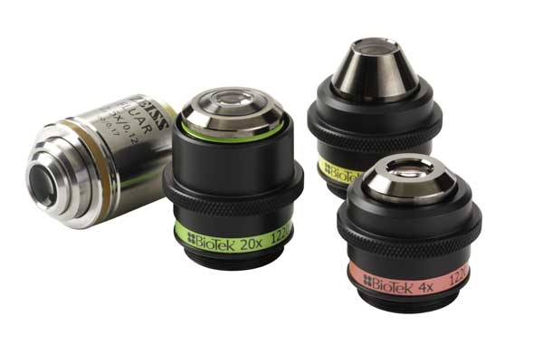
High Quality Optical Components
Semrock filters
High power color LEDs
Zeiss & Olympus objectives
16-Bit CCD camera with Sony chip
Results in high-quality images

Slide 38
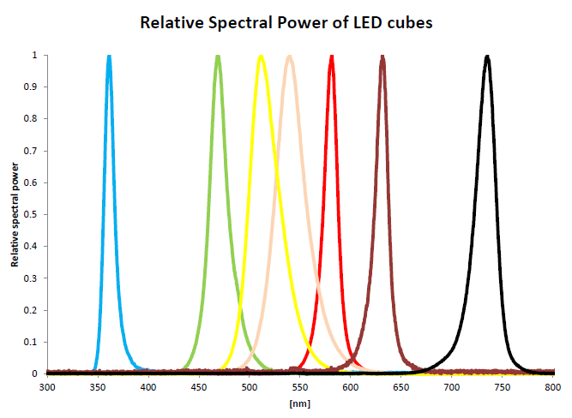
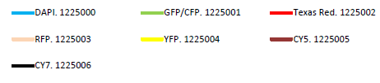
Wide spectral range
8 standard imaging filter sets over a spectral range of 7 LED’s:
  DAPI
  GFP
  YFP
  RFP
  Texas Red
  CY5
  CY7
  CFP
  Custom…

Slide 39
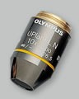
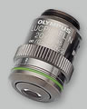
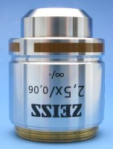
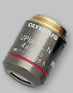
Available objectives (also called ‘lenses’)
No-brand 2x
Zeiss 2.5x
Olympus 4x
Olympus 10x
Olympus 20x
Plus soon to launch 40x and 60x!

Slide 40
Magnification v’s well size
2x
2.5x
4x
10x
20x
96-well
6.5 mm
384-well
3.7 mm

Slide 41
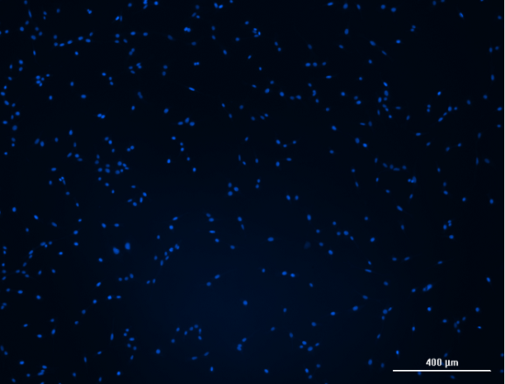
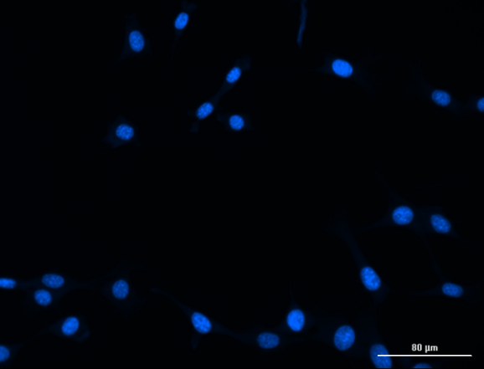

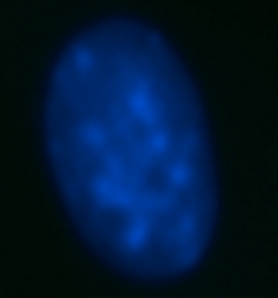
Magnification v’s pixel size
2.5x
3 x 2.3 mm
4x
2 x 1.5 mm
10x
0.8 x 0.6 mm
20x
0.4 x 0.3 mm
384-well
3.7 mm

Slide 42
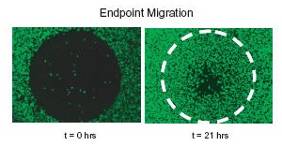

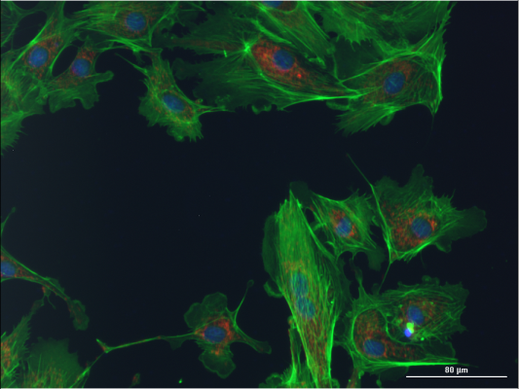

Magnification and example of applications
4x
2 x 1.5 mm
20x
0.4 x 0.3 mm
2.5x
3 x 2.3 mm
No cell details at all
Counting could be difficult (many overlapping objects)
In this case, total image intensity would be used rather than count.
Limited cell details
Allows counting, and many cells are visible so good statistics
Cytotoxicity, cell proliferation assays
Intracellular details visible
Qualitative information about location of fluorescence in cells
Advanced image analysis can be performed in Gen5 or third party software.
Apoptosis, translocation events…

Slide 43
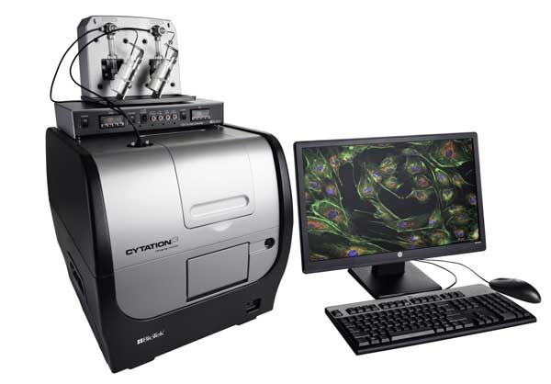
More and More Assays are Run on Live Cells
Cytation3 live cell features:
Temperature control up to 45 ºC
Gas controller (CO₂ / O₂)
Automatic reagent dispenser

Slide 44
‘Pain-points’ Associated with Imaging Microplate Cell Based Assays
Why Cytation3 eases that pain…

Slide 45
‘Pain Areas’ in Imaging
Software
  Very complex
  Need a specialist
Resource issues
  Instruments are expensive and often shared in core facilities and not in your lab
  Work flow planning & scheduling
  Often an expert is required to help
Data Storage
  Large amounts of data generated
    1 image of 1 well = 2.5 MB
    1 384 well plate = 960MB
  Additional server needed for data management ($$$)

Slide 46
Ease the pain
Software
  Easy to use Gen5
  Familiar Microplate based
  Simple learning curve
Scheduling of resources
  Cost effective
    Reader, Microscope, Imager all in one
    Cost of a high-end microplate reader system
    Bench-top, personal system
Data storage
  Hit picking
  Reduces plate file sizes
  Focuses on the areas of interest

Slide 47
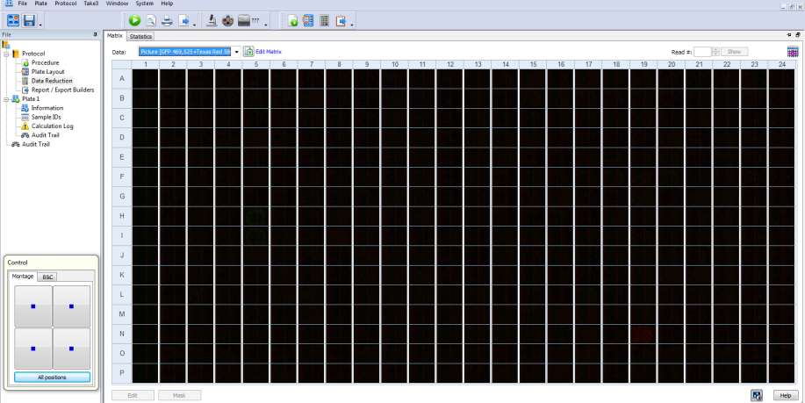
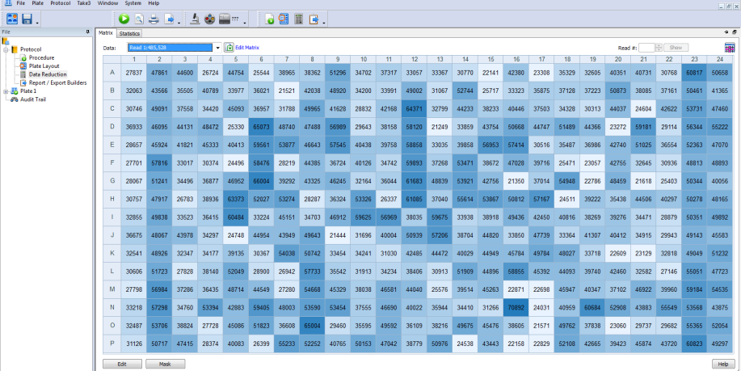
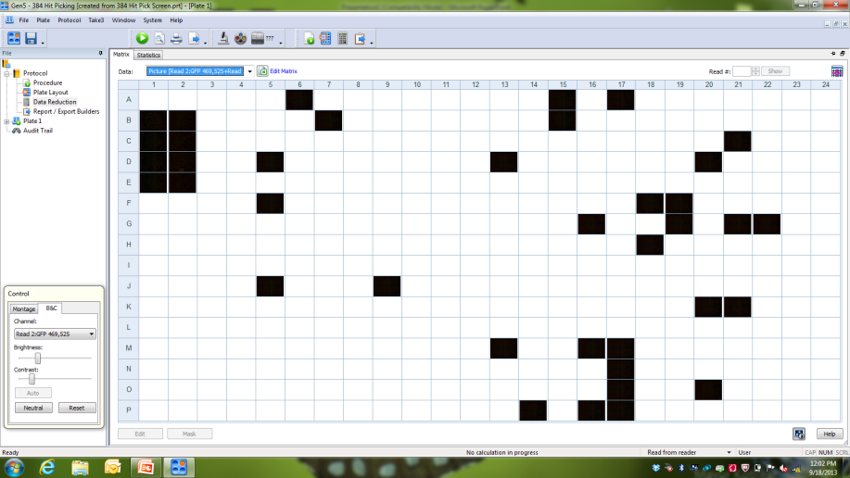
Cytation3: Hit Picking Advantage
Image Full Plate
GFP Fluorescence Plate Read
vs.
 | Full Plate | Hit Wells
Image Acquisition Time* | 2 hr | 17 min
Image Analysis Time** | 9 min | 1 min
Hard Disk Space | 6.5 GB | 650 MB
If GFP RFU<26000, then image well
*384 well plate, 2x2 montage in 2 channels, 4x objective
**Cell counting in 2 channels

Slide 48
Examples of applications using the Cytation3

Slide 49
Cytation3 Applications
Multimode Detection Applications
Apoptosis
Bacterial adhesion
Biofuel research
Calcium mobilization
Cell adhesion
Cell expression
Cell proliferation
Cell viability & cytotoxcity
Chemotaxis
Colorimeric assays
Cytochrome P450 induction/inhibition
Cytokine analysis
DNA quantification
eGFP quantification
ELISA
Enzyme activity
Enzyme kinetics
Epigenetics
Immunoassays
Kinase assays
Kinetic yeast growth profiles
Live cell analysis
Metabolic activity
Mitochondrial membrane potential
NADH/NADPH
Na⁺/H⁺ exchange
Nucleic acid quantification
Imaging Applications
Cell Migration
  Scratch Assay
  Wound Healing (Oris Assay)
Colocalization
Counting
  Cell Proliferation
  Cell Toxicity
  Cell Viability
  Nuclear Count
  Whole Organism Counting (C. Elegans)
Hypertrophy
Hit Picking
Montage
Neurite Outgrowth
Nuclear Translocation
  Caspase-3 translocation during apoptosis
Protein Expression
  P53, P21, c-Jun
Subpopulation Analysis
  Apoptosis/Necrosis
  Cell Cycle
  Cell Infection by virus/parasite
  Hypoxia& Oxidative Stress
  Mitotic Index
  Protein Expression
  Transfection Efficiency
Time Lapse/Kinetics
  Caspase-3 translocation
Oxidative burst
Oxidation reactions
PAMPA
PCR product quantification & quality
Protease activity
Protein aggregation
Protein quantification
Receptor binding studies
Reporter gene
Signal transduction
Single Nucleotide Polymorphisms
Spectral Scanning
Toxicology
Quantitative numerical data

Slide 50
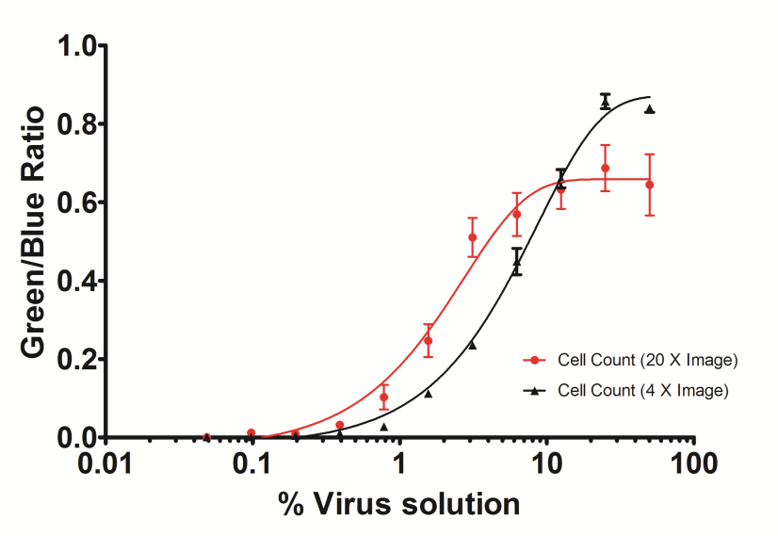
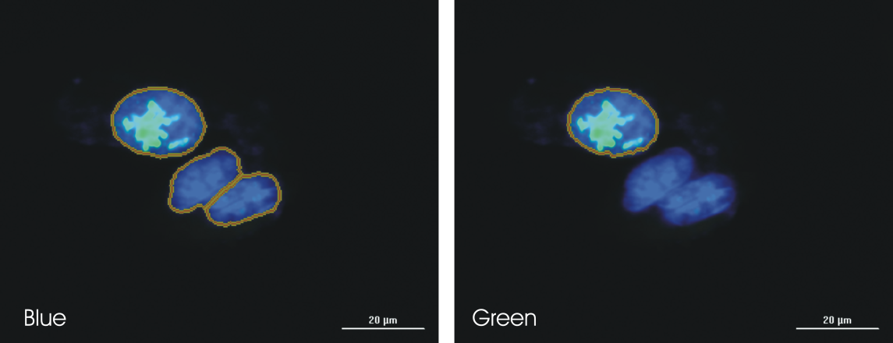
Transfection Efficiency …
GFP Transfection efficiency in U2-OS cells using BacMam
… simple ratio of blue and green channel cell counts

Slide 51
Transfection Efficiency – Time Course Study
U-2 OS cells infected with virus
4X images taken every 2 hours
Cellular expression of GFP fusion protein visible via fluorescence as soon as 6 hours
Maximum expression reached between 16 and 20 hours
Qualitative phenotypic data

Slide 52

HTRF IL-6 Secretion Assay – Spectral Filters and Imaging
Toxicity Assessment …
4x images of LIVE (blue) and DEAD (red)
[AG 1478] ≈ IC₅₀: 5.5% DEAD cells
[AG 1478] = 5 mM: 94.3% DEAD cells
Toxicity contributing to AG 1478 potency
Qualitative phenotypic data

Slide 53



Toxicity Assessment – Workflow Overview
16ul transfer to 384
Well plate
Cells +
Compounds
1 hr. incubation
EGF 48 hr. incubation
Add HTRF reagents
Top read, filters, dichroic
LIVE/DEAD Assay
Of hit wells
Bottom read, Imaging

Slide 54

Chemical Hypoxia Induction – Whole Well Intensities
Phenotypic Assays …
Rapid measurement of oxidative stress and hypoxia
  Oxidative stress (green) measured with spectral filters/dichroic
  Hypoxia (red) with monochromators
Qualitative phenotypic data

Slide 55

Subpopulation Analysis – 20x Imaging
Phenotypic Assays … (Continued)
100 μM
500 μM
1 mM
Data represented as % of total cells as determined by nuclear stain
  Blue: Hoechst 33342 stained
  nuclei
  Green: Oxidative stress
  Red: Hypoxia
Qualitative phenotypic data

Slide 56




Phenotypic Screening …
Screen for Hypoxia Inhibition (monochromators)
REDOX library screened against hypoxic conditions (500 μM CoCl₂)
Numerous compounds inhibit hypoxia
Gossypol: 216% Inhibition/
Evidence of Cytotoxicity
NDGA: 100% Inhibition/ 5% Effected Cells
N-Octyl caffeate: 50% Inhibition/ 61% Effected Cells
No Compound Control: 0% Inhibition:/80% Effected Cells
Notes:
Negative control still gives fluorescent value, which is why 3 of the wells actually could give above 100% inhibition.
Effective cells are the Red/Blue count.
** The % Inhibition is based on monochromator reading, and not on imaging analysis.

Slide 57
Phenotypic Assay Workflow – Hypoxia / Oxidative Stress
Assay Development
Screening
Hit Confirmation
Confirm reagents work
Since optimized for Flow/Microscopy
Validate oxidative stress
does contribute to hypoxia
Confirm CoCl2 control
using Imaging
Monochromator read
With Imaging Hit Pick
Monochromator dose-
response inhibition
Luminescence Cell-titer
Glo Cell-viability
Imaging
+
Monochromator
+
Luminescence

Slide 58



Cell Migration…
Notes:
Previously the Oris assays was validated on Synergy readers using bottom detection. The assay uses a cell seeding stopper and a physical mask fitted beneath the plate; manual process not amenable to HTS
Oris Pro uses a non-toxic biodegradable gel (BCG) that dissolves after cell plating.

Slide 59
Cell Migration…
Cell migration: translocation of cells in response to events, biological or environmental signals
Biological processes: immune response, wound healing
Disease: movement of wrong cell type to wrong place
  Mental retardation
  Cardiovascular disease
  Arthritis
  Tumor formation and metastasis
Types of cell migration
  Chemotaxis- movement toward or away from chemical signal
  Cell invasion-cells move through extracellular matrix into adjacent tissue
  Transmigration-migration through vascular endothelium toward chemical signal (leukocytes or tumor cells)
Comley, J. (2012/2013): Cell Migration. probing cell movement with smarter tools. In Drug Discovery World ,Winter, pp. 33–51, checked on 15/05/2013.

Slide 60


Cell Migration – Statistical analysis using Std Deviation
A
B
C
D
E
F
G
H
Std Dev [GFP 469,525]
[CD] (uM) | mean | stdev
1.000 | 499.7 | 193.5
0.333 | 1207.0 | 582.2
0.111 | 1632.3 | 419.0
0.037 | 3097.3 | 365.5
0.012 | 3504.0 | 95.1
0.004 | 3813.3 | 188.5
0.001 | 3732.3 | 252.0
0.000 | 3483.3 | 206.9
~7-fold assay window
30K cells/well
3 4 5

Slide 61
Conclusions
Cytation3 – three separate optical paths
  Digital widefield fluorescence microscopy (2x, 2.5x, 4x, 10x, 20x)
    rich phenotypic data
  Excitation and Emission monochromators with quadruple gratings
    wavelength selection flexibility
  Excitation and emission spectral filters separated by dichroic mirror
    high sensitivity detection
Enables target-based and phenotypic assays
Detection modes available: absorbance, FI, FRET, TRF, FP, luminescence, widefield Fluorescence microscopy, bright field microscopy
Qualitative phenotypic data

Slide 62

Microplate Reader with Imaging…
Quantitative numerical data
Quantitative numerical data
Fuller picture for cell biology research
Qualitative phenotypic data
Qualitative data

Slide 63

Thank you! Stay connected with us ….
For Application papers and Technical Resources, visit: http://www.biotek.com/resources
Sign up for TekTalk, our Quarterly E-Newsletter:
http://www.biotek.com/tektalk
Visit our blog “Scientifically Speaking”: http://blog.biotek.com
http://twitter.com/biotektalk
http://facebook.biotek.com

