Slide 1


Slide 2






Cell Counting Chambers
www.chemometec.com

Slide 3

Limitations of manual
and brightfield-based cell counting
Subjectivity (‘definition’ of cell)
Sample handling (volume, dilution and pipetting errors)
Narrow concentration range
Inclusion of debris and artifacts
Handling of chemicals
Labor intensive
Time consuming
www.chemometec.com
Notes:
Hemocytometer: manual cell counting methods
Several different dyes are explored in manual cell counting using the hemocytometer. The trypan blue exclusion method is widely used in laboratories for viability determination. Trypan blue only enters cells with impaired plasma membranes. The membrane of viable cells excludes the dye, and stained and non-stained cells are visualized in a light microscope. A drawback with this method is, however, that trypan blue has staining artifacts, and further more that the proportion of stained cells increases with incubation time (Jones, K.H., Senft, J.A. J. Histochem. Cytochem. 33, 77-79 (1985)). Cells are classified as non-or viable due to the subjective judgment of the operator. Fluorometric cell viability determination using dyes like acridine orange and propidium iodide are generally regarded as superior to the trypan blue exclusion method with regard to stain specificity and incubation stability (Mascotti, et al. Transfusion 40, 693-697 (2000)). However, the cost of fluorescence microscopes has discouraged most laboratories from using this method. The naked eye can only differentiate between cells in a limited concentration range in the hemocytometer chamber. This, combined with the potential problem of cell aggregation and the small volume analyzed in a hemocytometer, means that most laboratories find it difficult to obtain high precision using the manual methods.

Slide 4
Hard to discriminate cells from debris by microscopy
Easy to count nuclei by fluorescence microscopy
www.chemometec.com

Slide 5

NucleoCounter®
The first fluorescence-based automated cell counters in the market
The xC-100 product family :
    NC-100™ Mammalian cells in cell cultures
    YC-100™ Yeasts cells in beverage and biotech/pharma
    SP-100™ Sperm cells in semen
    SCC-100™ Somatic cells in milk
www.chemometec.com

Slide 6
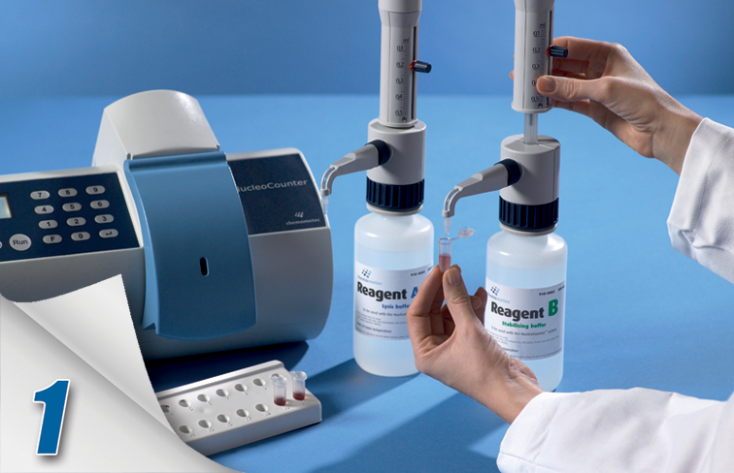
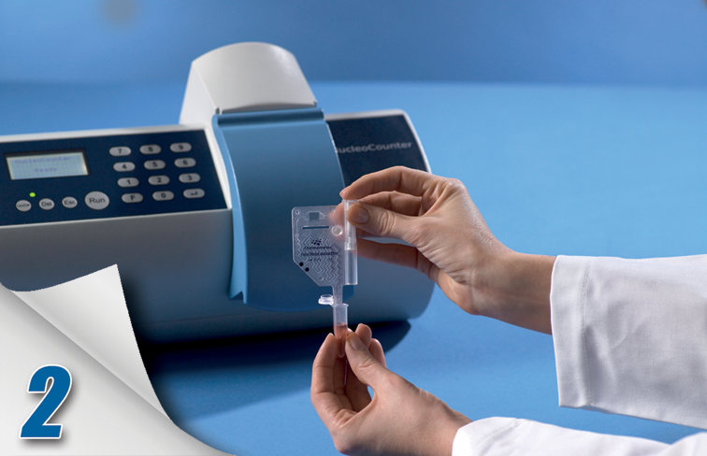
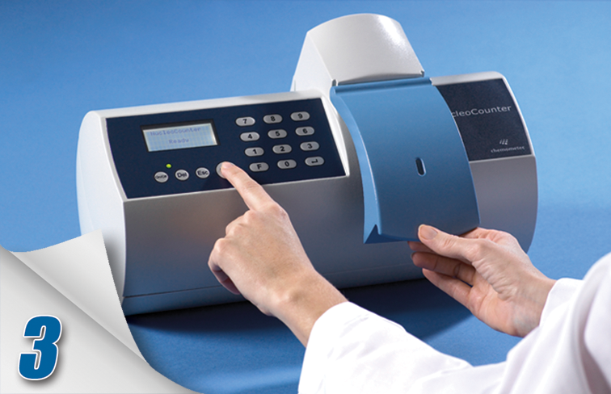
NucleoCounter® Concept
Automation, reliability and ease in operation
Lyse Load Count
www.chemometec.com

Slide 7
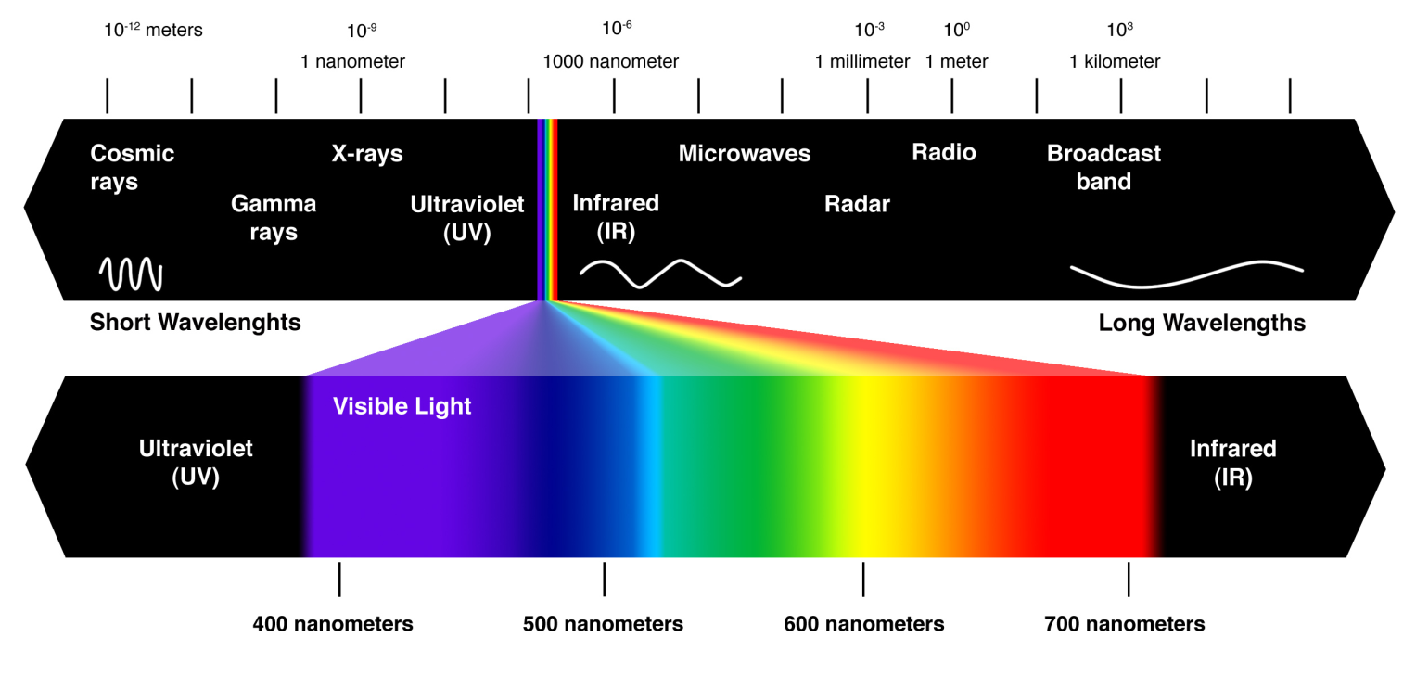
NucleoCounter® Technology
Fluorescence is the emission of light by a substance that has absorbed light or other electromagnetic radiation. In most cases, the emitted light has a longer wavelength, and therefore lower energy, than the absorbed radiation (Stoke’s Law).
www.chemometec.com

Slide 8
NucleoCounter® Technology
Integrated Fluorescence Microscope
Lenses: magnification <1X.
Excitation filter: sorts out green light.
Emission filter: sorts out long wave length including red light.
CCD: Charged Coupled Device
LED: Light Emitting Diodes
www.chemometec.com

Slide 9
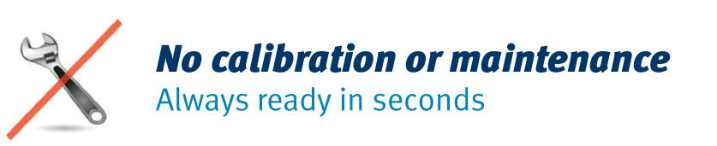
NucleoCounter® Technology
Highly reliable LEDs
Minimal intensity drift after millions of measurements.
www.chemometec.com

Slide 10
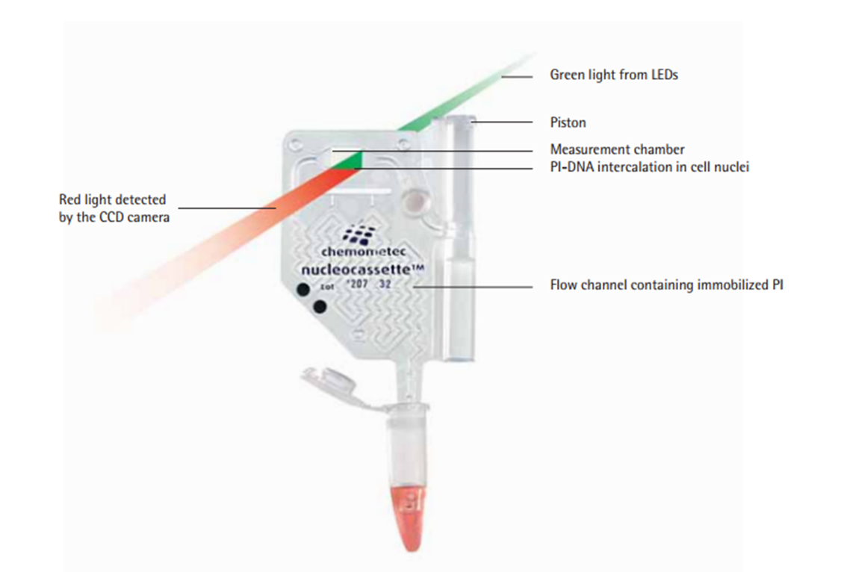
NucleoCassette™
Sensitive parts, moving parts and “wear and tear” parts have been taken out of the instrument and integrated in the disposable NucleoCassette.
Pump
Tubing’s
Mixer
Precision optics
Chemicals
Calibration
Waste container
All-in-one,
easy-to-use
solution
www.chemometec.com

Slide 11
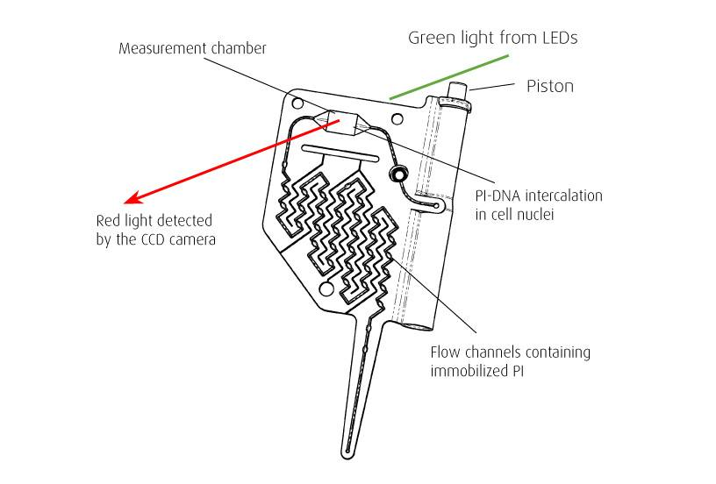
NucleoCassette™
  Internal Chemistry: Propidium Iodide
  No spills or chemical handling
  Fully automated analysis
  Easily disposable
  No volume calibration:
  Laser-calibrated thickness
  of measuring chamber (dot code)
www.chemometec.com

Slide 12
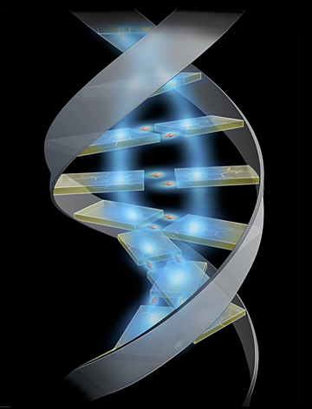
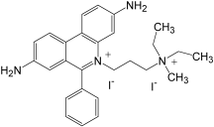
NucleoCassette™
Propidium Iodide dye
1 dye molecule per 4-5 bp
Genome between 2.5 x 10⁹ – 4.0 x 10⁹ bp.
DNA base pair (bp):
A: Adenine
T: Thymine
G: Guanine
C: Cytosine
C₂₇H₃₄N₄²⁺.2I⁻ MW 668.4
www.chemometec.com

Slide 13
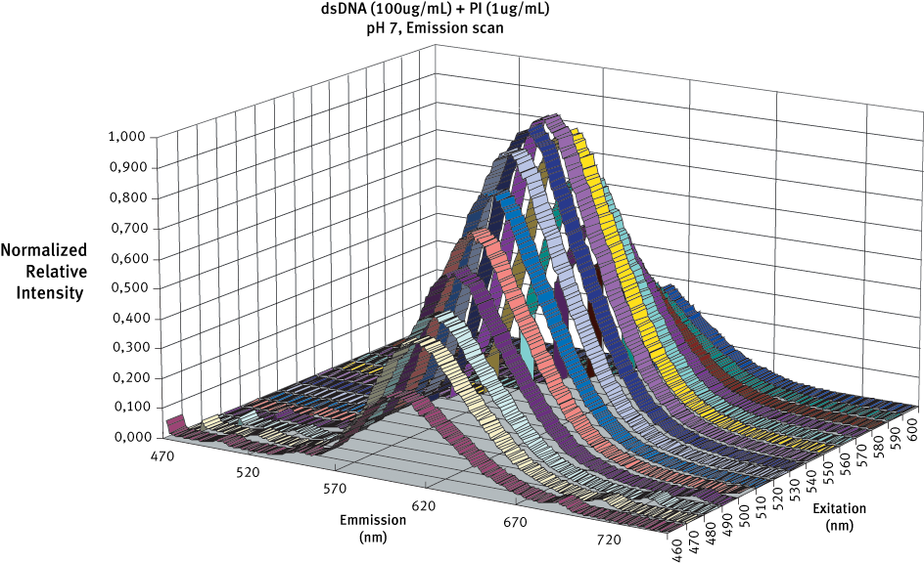
NucleoCassette™
Spectral behavior of dsDNA + PI fluorophore
www.chemometec.com

Slide 14
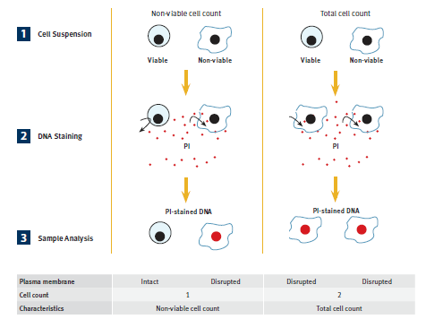
Assessing Cell Viability
www.chemometec.com
Notes:
From these two measurements it is possible to calculate the concentration of viable cells in the suspension (subtract the non-viable cells from the total concentration of cells) and thereby calculate the viability in percentage. I will show this in the demonstration.

Slide 15
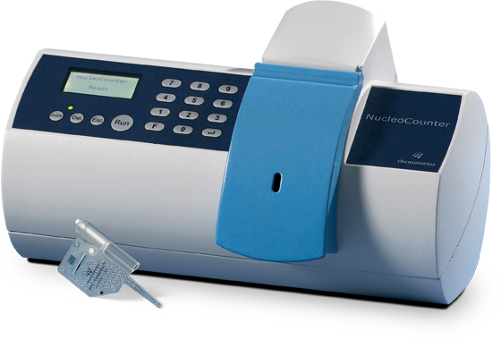
NucleoCounter® NC-100™
Fast, precise and objective counting and
viability determination of mammalian cells
Ideal for cell cultures from:
TC-flasks,
Bioreactors
Microcarriers
Etc
www.chemometec.com

Slide 16
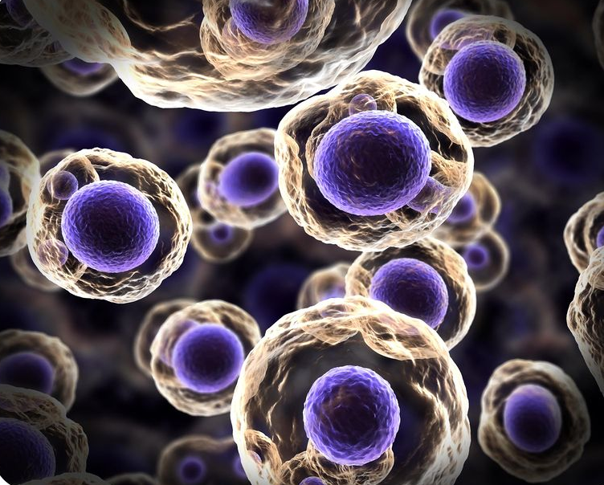
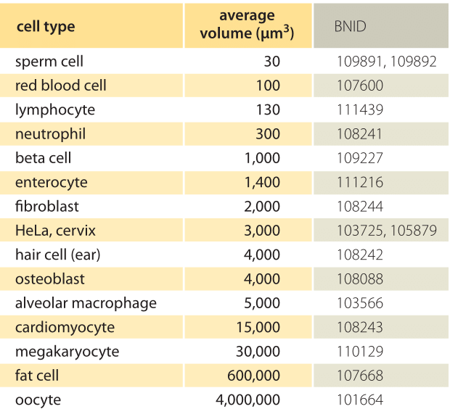
NucleoCounter® NC-100™
Robustness of results.
Mammallian cell size can vary largely (see table).
The typical diameter varies between 20-40 μm.
Nuclei are almost uniform in size, ranging between 10-12 μm (Genome between 2.5x10⁹ – 4.0x10⁹ bp)
Advantage of measuring nuclei:
No calibration to cell type (size) using the NucleoCounter® NC-100™.
www.chemometec.com
Notes:
Although the cell size may differ greatly in mammalian cells, the genomic size is close and the size of the nuclei are almost uniform.
This gives an exceptional advantage of the NC system, since no calibration to the specific mammalian cell type is necessary.

Slide 17
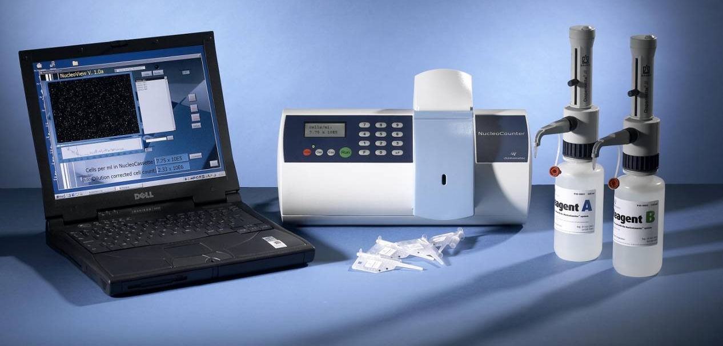
NucleoCounter® NC-100™
The five-components concept:
NucleoCounter® NC-100™
NucleoView Software
Lysis Buffer
NucleoCassette
Stabilizing Buffer
Notes:
The NucleoCounter system consists of 5 components.
Four of them are necessary to perform a complete analysis. You need the reagents to lyse your cells, you need the NucleoCassette for the automatic staining of your nuclei and finally you need your NucleoCounter to detect the fluorescent signal from the stained nuclei.
Optionally you can use the NucleoView software for data processing

Slide 18
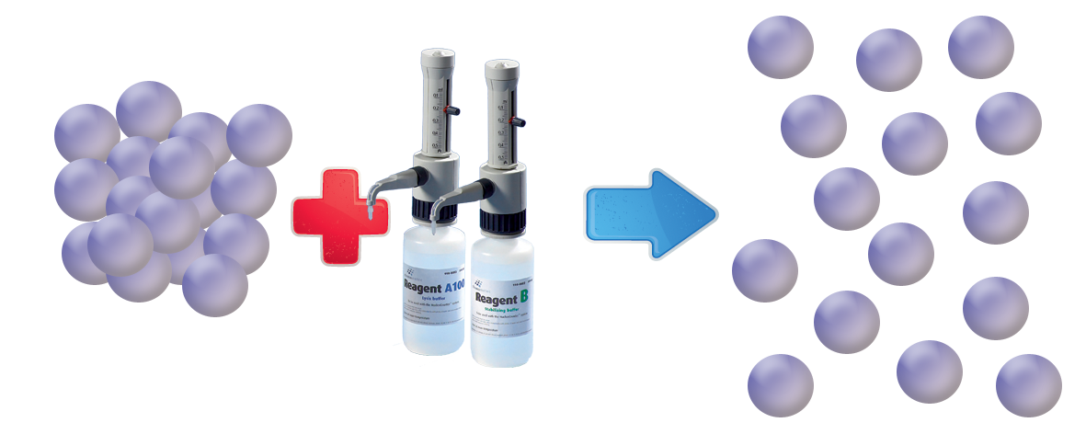
Total count using Reagents A100 and B
Release of nuclei
Cell cluster separation
Accurate total cell count
Lysis reagent A-100: Disrupts the plasma membranes of the mammalian cells, rendering the nuclei susceptible to staining with PI
Stabilizing reagent B: Raises the pH value, allowing PI to stain the DNA of the cells more efficiently
www.chemometec.com
Notes:
Although the cell size may differ greatly in mammalian cells, the genomic size is close and the size of the nuclei are almost uniform.
This gives an exceptional advantage of the NC system, since no calibration to the specific mammalian cell type is necessary.

Slide 19
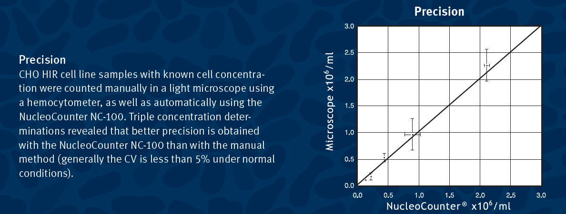
Comparison
NucleoCounter® NC-100™ vs. Hemocytometer
www.chemometec.com
Notes:
From these two measurements it is possible to calculate the concentration of viable cells in the suspension (subtract the non-viable cells from the total concentration of cells) and thereby calculate the viability in percentage. I will show this in the demonstration.

Slide 20
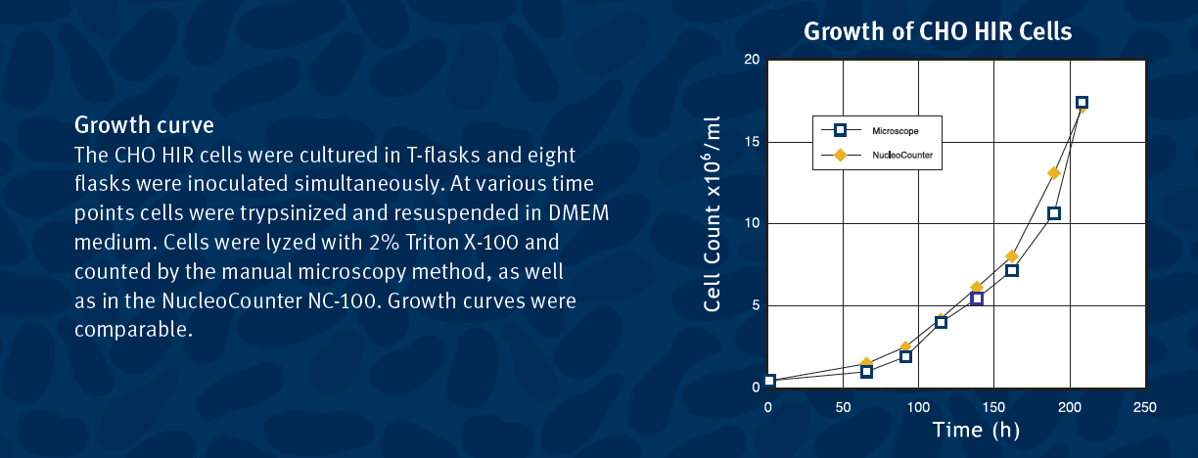
Comparison
NucleoCounter® NC-100™ vs. Hemocytometer
www.chemometec.com
Notes:
From these two measurements it is possible to calculate the concentration of viable cells in the suspension (subtract the non-viable cells from the total concentration of cells) and thereby calculate the viability in percentage. I will show this in the demonstration.

Slide 21
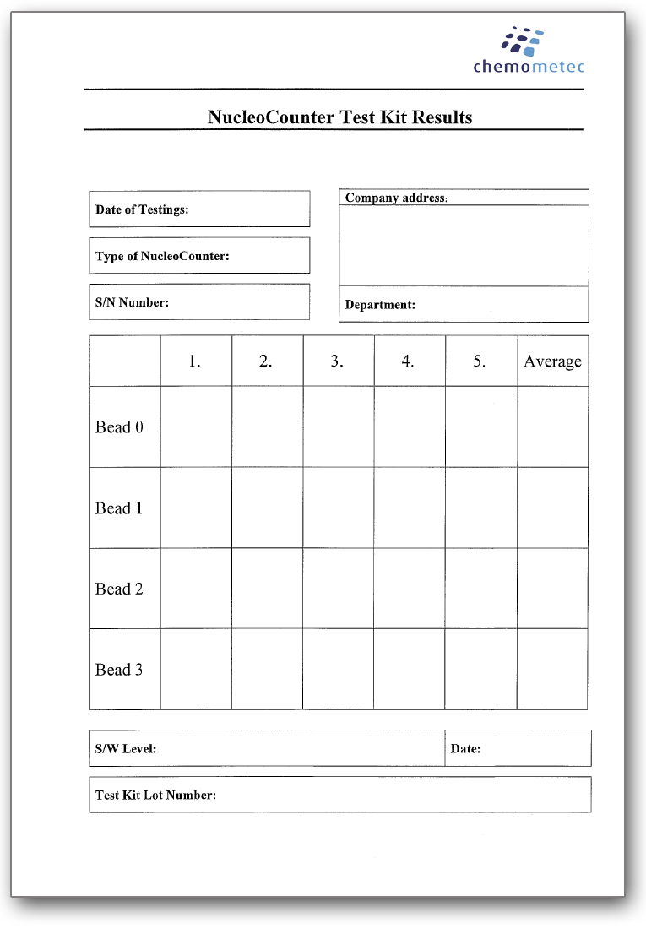
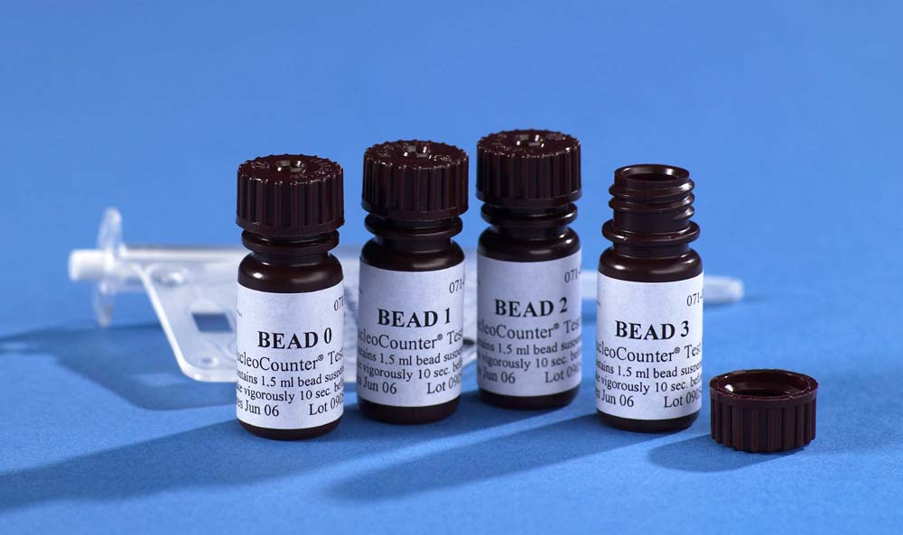
Validation
Installation &
Operation Qualification (IQ/OQ)
www.chemometec.com
Notes:
From these two measurements it is possible to calculate the concentration of viable cells in the suspension (subtract the non-viable cells from the total concentration of cells) and thereby calculate the viability in percentage. I will show this in the demonstration.

Slide 22
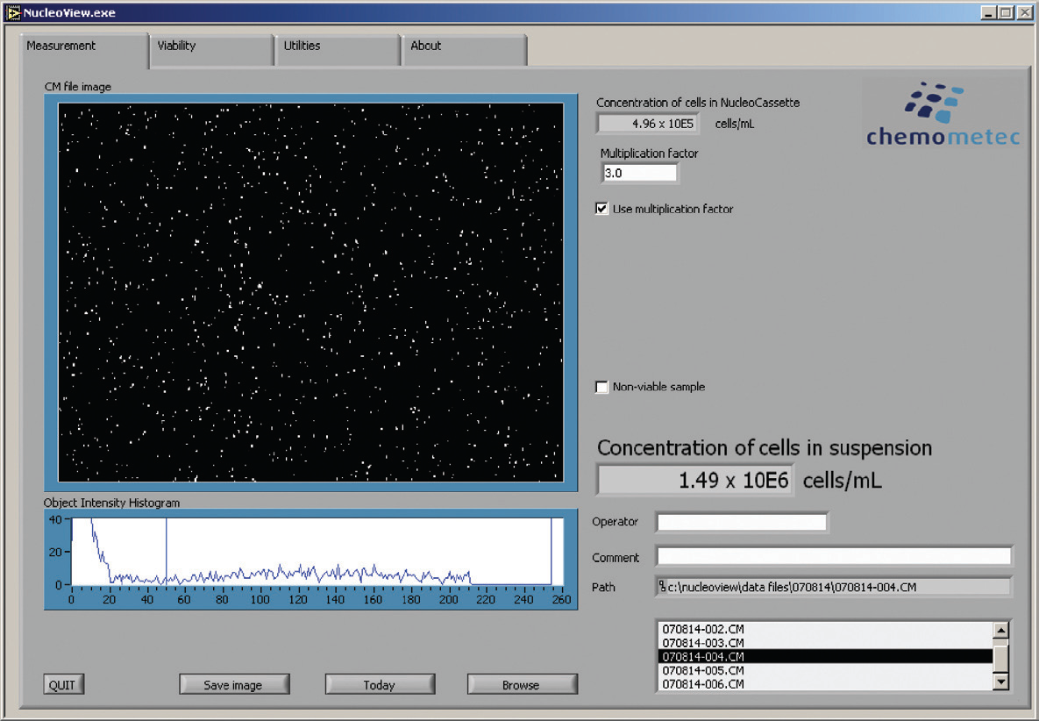
NucleoView™ Software
www.chemometec.com
Notes:
How are data presented in the NucleoCounter ® NC-100™
The NucleoCounter NC-100 display
Data are always presented in the NucleoCounter NC-100 display as the number of cells per ml present in the NucleoCassette chamber.
For documentation and further data processing the NucleoCounter NC-100 system can be supplied with a CD-ROM containing the NucleoView software application. By connecting the NucleoCounter NC-100 to a PC and installing the software you will find data presentation that offers several advantages:
1 Printing and saving data for documentation purposes.
2 Captured visualized image for user evaluation. Cell or nuclei aggregates are easily observed in this image.
3 The count is corrected for dilution by the multiplication factor in order to obtain the cell concentration in the cell suspension prior to dilution.
4 Viability calculation.

Slide 23
NucleoCounter® NC-100™
Easy operation – no preparation
High precision & reproducibility
30 sec. analysis time
Calibration free
No cleaning
Portable/compact
60 µl sample
Maintenance and service free
Safe sample handling and disposal
Detection range: 5 thousand to 2 million cells/ml.
Can be used as a stand alone unit
www.chemometec.com

Slide 24
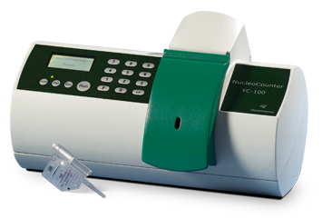
NucleoCounter® YC-100™
Optimized for fast, precise and objective counting and
viability determination of yeast cells
Ideal for:
Yeast cell lab
Yeast research
Fermentation tanks
Features:
NucleoView™ Software
Reagent Y100 (lysis buffer)
NucleoCassette™
www.chemometec.com

Slide 25
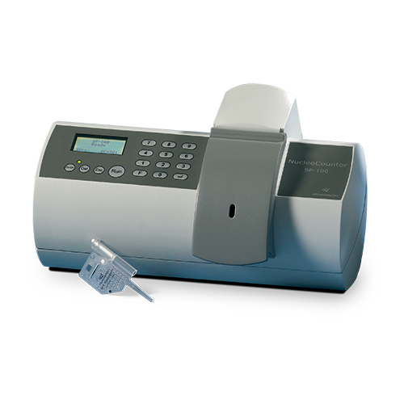
NucleoCounter® SP-100™
Optimized for fast, precise and objective counting and viability determination in semen samples from ejaculates or extended doses.
Ideal use in:
Artificial Insemination
Animal breeding
(Bulls, stallions, sheep, etc)
Features:
SemenView™ Software
Reagent S100 (lysis buffer)
SP1-Cassettes (PI dye)
www.chemometec.com

Slide 26
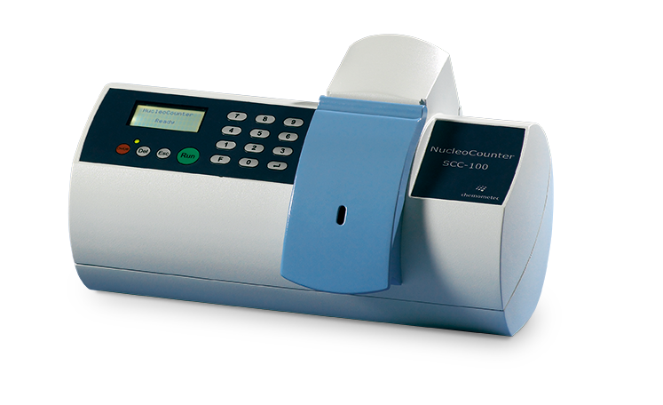
NucleoCounter® SCC-100™
Optimized for somatic cell counts in milk.
Ideal use in:
Milk quality assessment
Grading of milk
Features:
SomaticView™ Software
Reagent C (lysis buffer)
SCC-Cassettes (PI dye)
www.chemometec.com

Slide 27
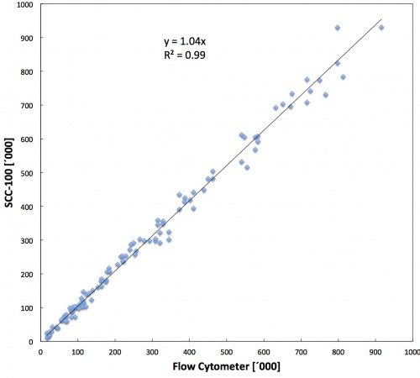

NucleoCounter® SCC-100™
Outstanding performance compared to industry standard flow cytometers.
www.chemometec.com

Slide 28
NucleoCounter® ‘xC-100’ family
Extreme ease of operation
30 sec. analysis time
Calibration free
No cleaning
Portable/compact
Minimal sample volume
Maintenance and service free
Safe sample handling and disposal
Broad density detection range
Low batch-to-batch variation because of calibration to reference standard
High reproducibility in yeast management and fermentation
www.chemometec.com

